Slide 1
IOT SMART FARMING SYSTEM 🌱🌾🚜
Welcome to the IOT Smart Farming System! This innovative solution is built on IoT technologies, empowering growers and farmers to enhance productivity and reduce waste. The system efficiently monitors crop fields using various sensors such as light, humidity, temperature, soil moisture, crop health, etc. It also automates the irrigation process, ensuring that crops receive optimal care and attention.

Slide 2
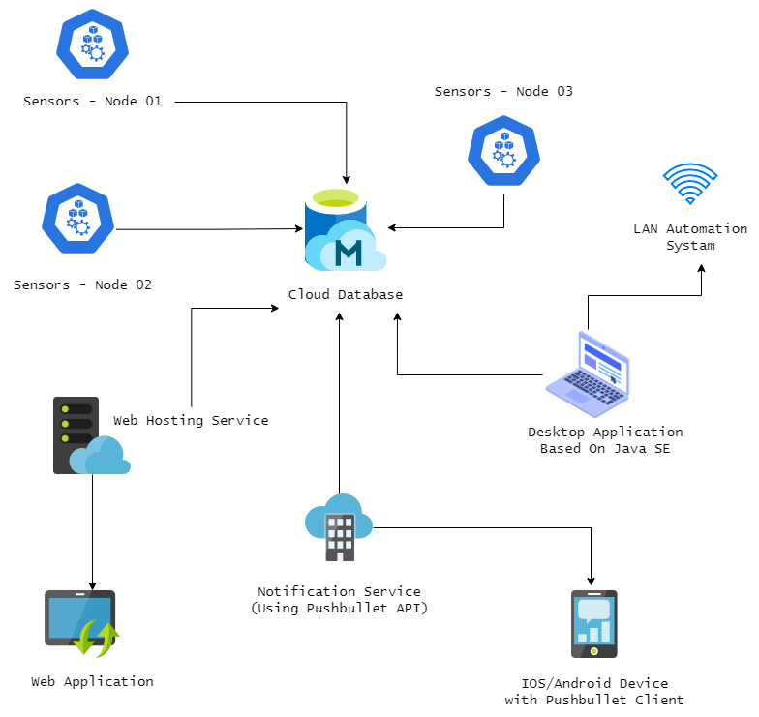
Architecture Diagram Proposal

Slide 3
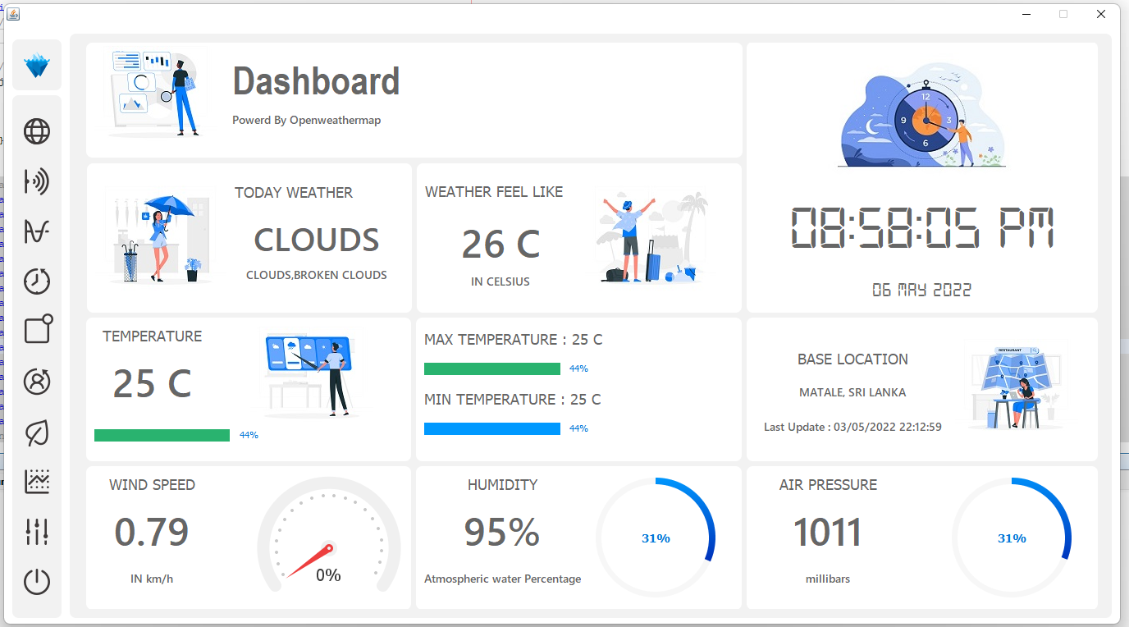
Dashboard Prototype

Slide 4
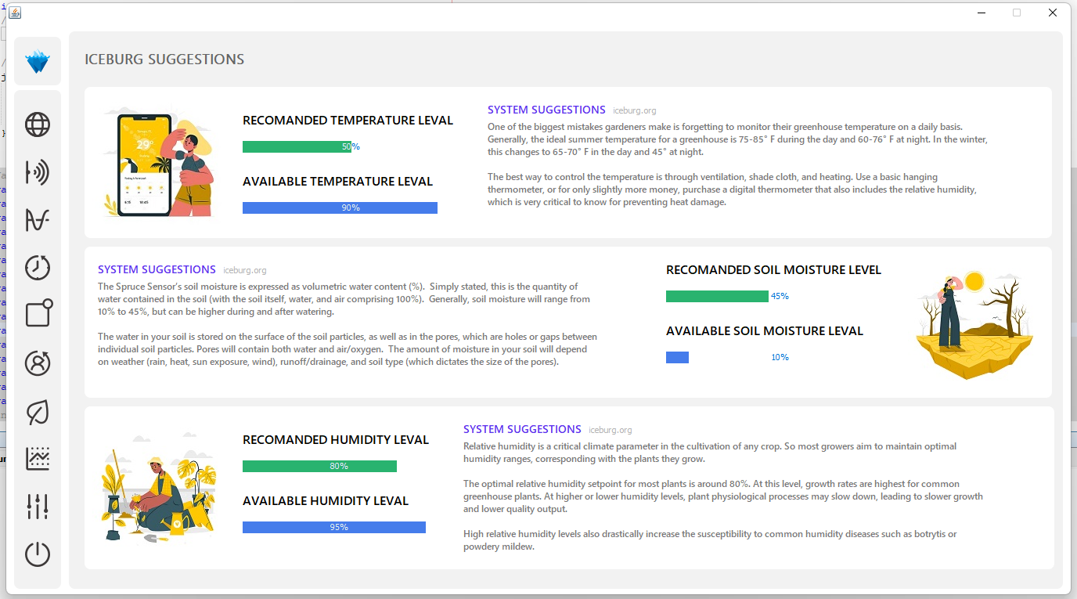
ICEBURG SYSTEM SUGGESTIONS

Slide 5
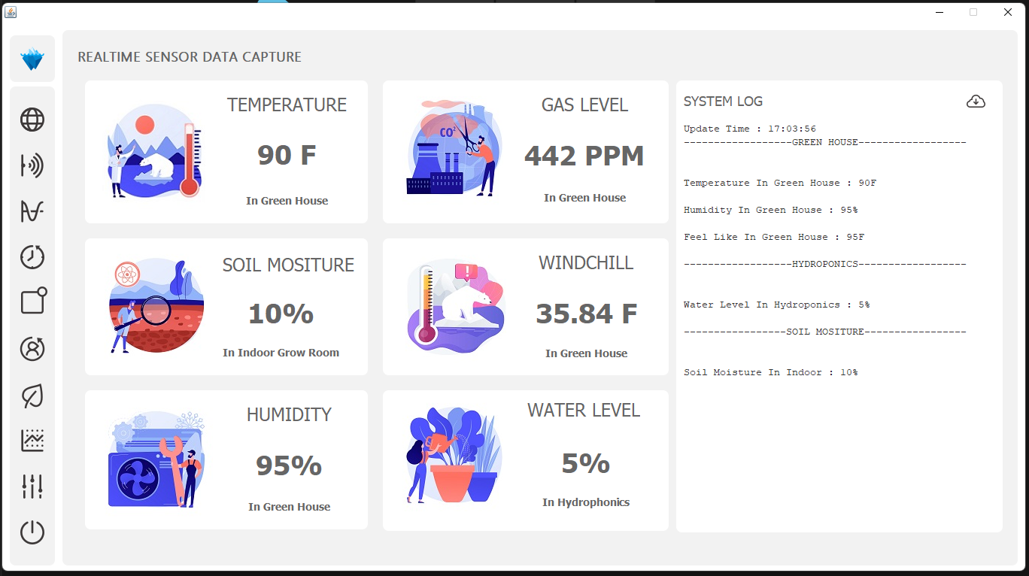
Real Time Sensor Data Captured

Slide 6
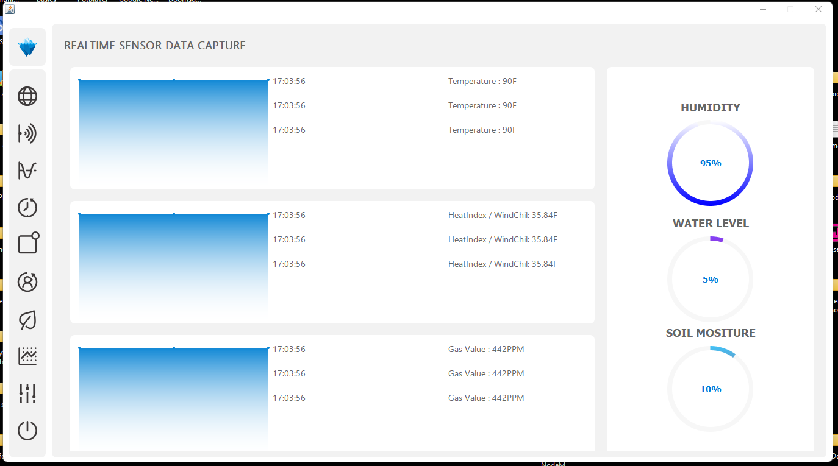
Real Time Sensor Data Captured over-View

Slide 7
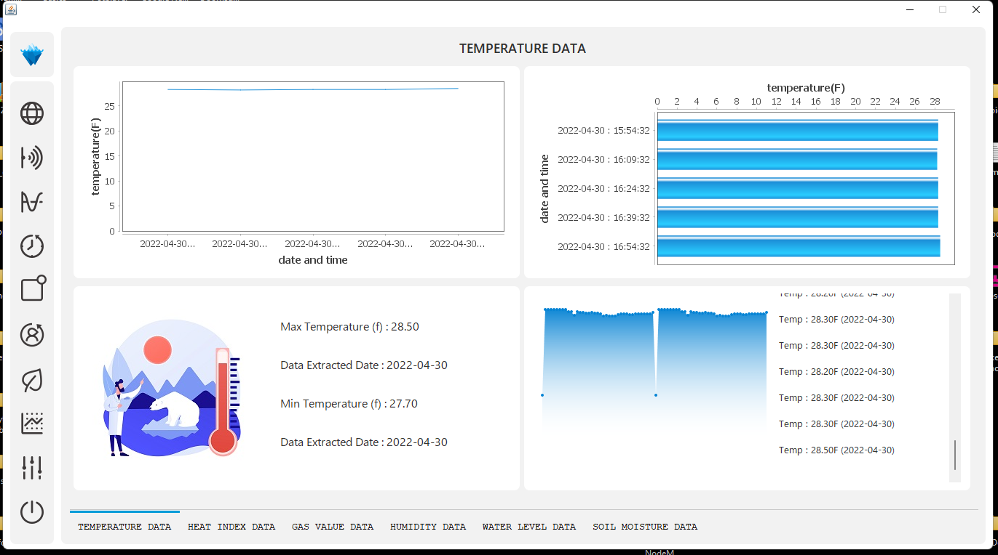
Specific sensor Captured Datas

Slide 8
Server Comparison Summary
Linode stands out as the best choice for our IoT project due to its balance of cost and performance:
Pricing: $5/month for basic plan (1 GB RAM, 1 vCPU).
Features: Simple pricing, good performance, developer-friendly, reliable support.
Comparison:
Cheapest: SWRVER ($3.99/month) but with limited features.
High Scalability: AWS and GCP offer extensive features but at higher costs.
Specialized: Akamai is best for content delivery, not general hosting.
Why Linode? It offers a cost-effective solution with sufficient performance and ease of management, making it ideal for small to medium IoT projects.

